Slide 1

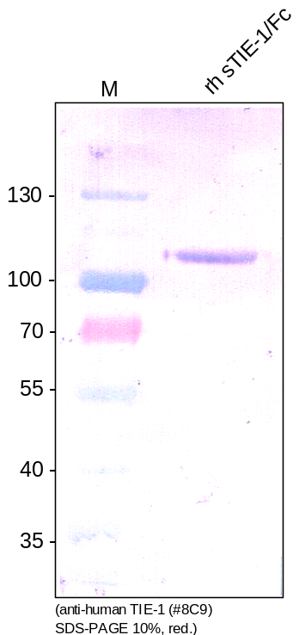
ReliaTech GmbH
Mouse anti-human TIE-1 #8C9
(Cat #101-M46)
Figure 1. Western analysis of recombinant human soluble TIE-1/Fc chimera [Cat# SFC-011] using a mouse monoclonal anti-human TIE-1 #8C9 antibody [Cat# 101-M46].
http://www.reliatech.de / orders@reliatech.de

